Slide 1
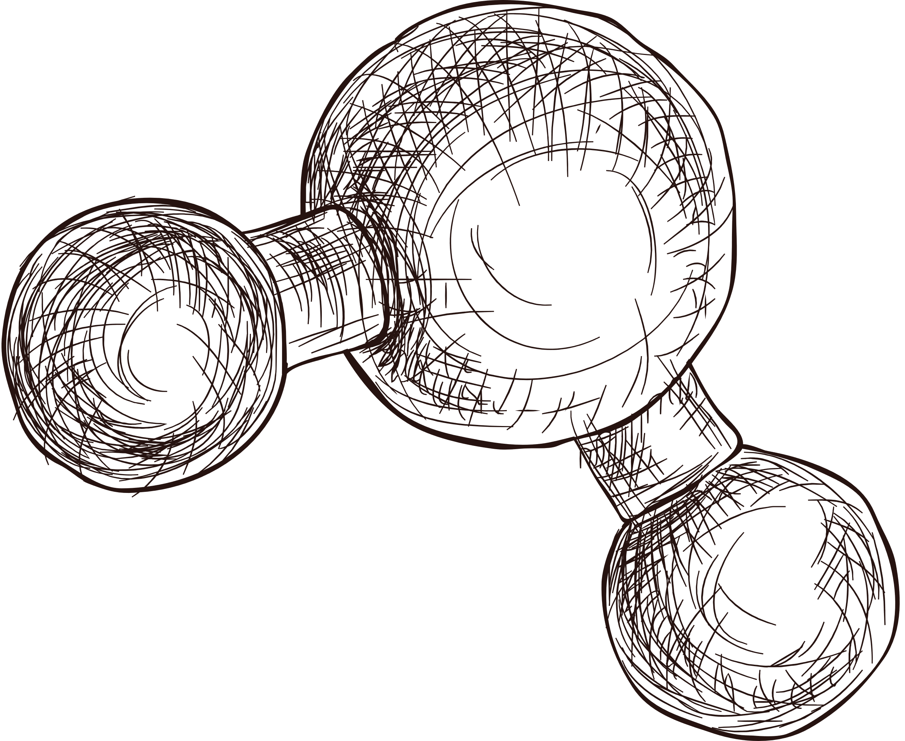

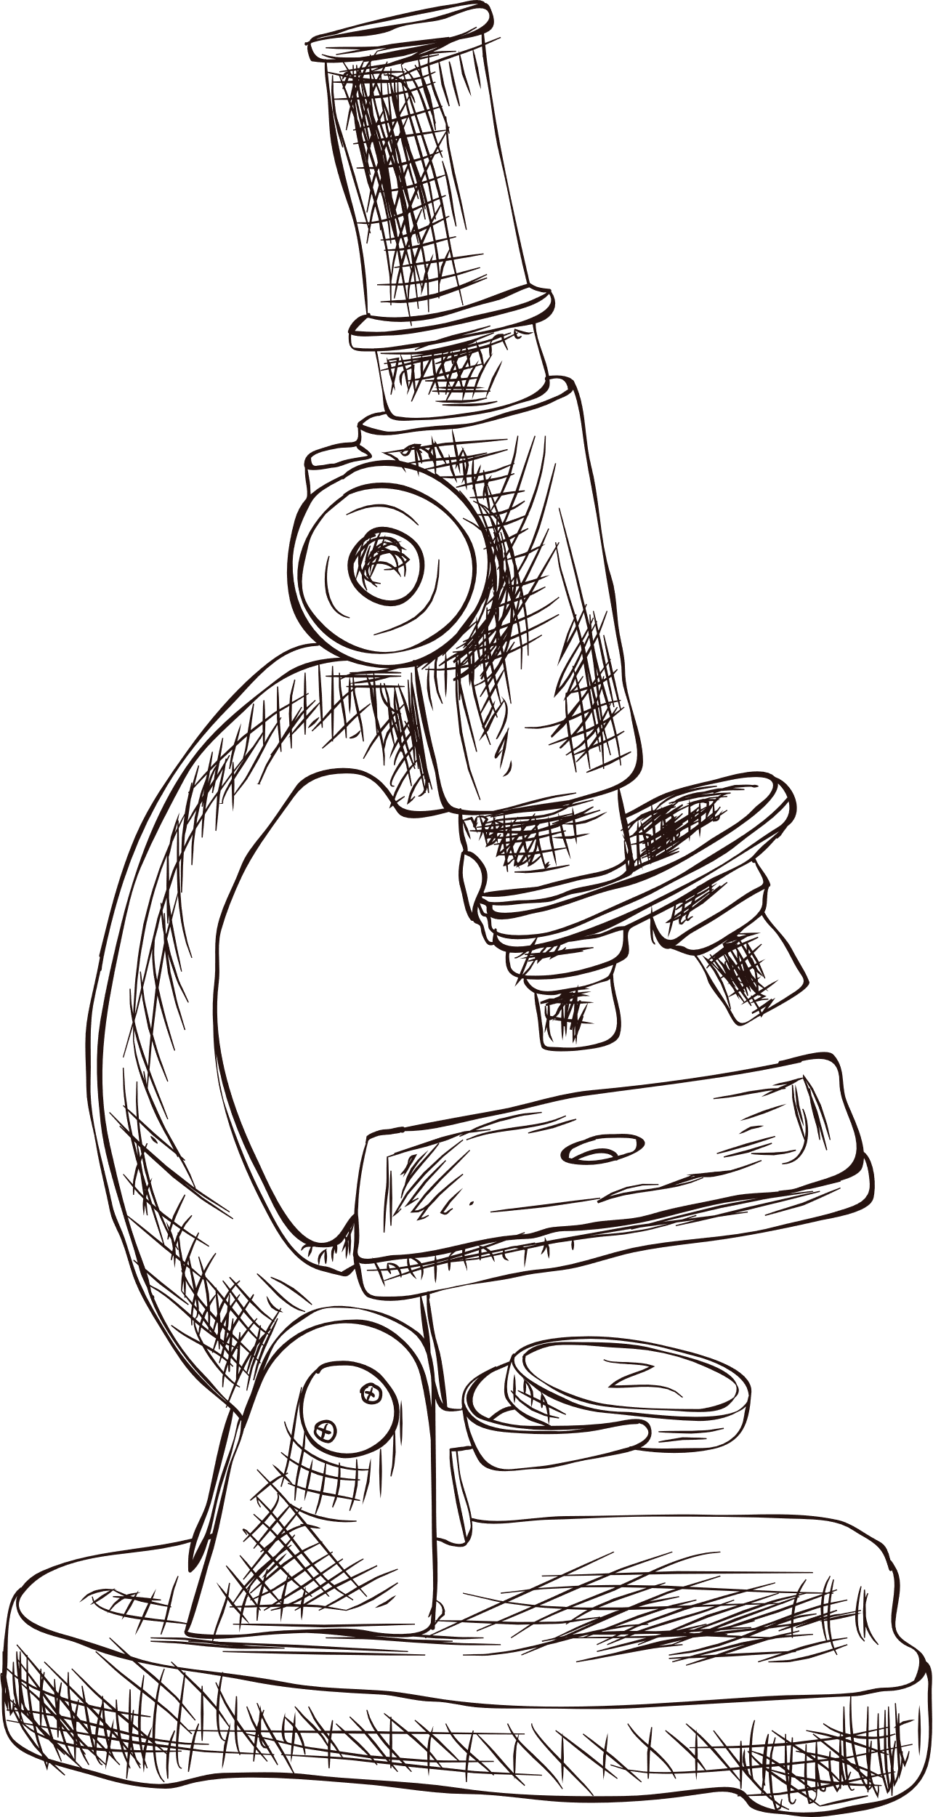
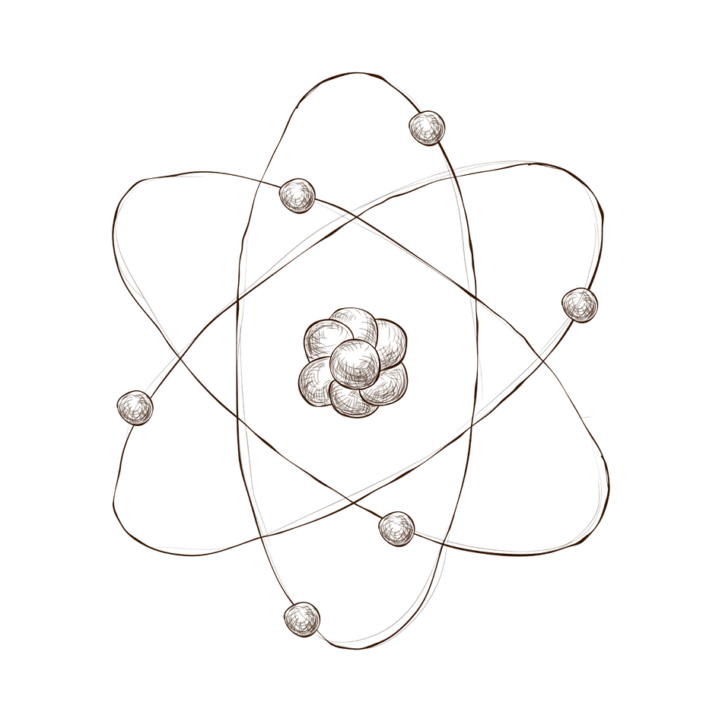

Ultrasound Therapy for cancer
HISTOTRIPSY
Presented by THU TA ZAW

Slide 2
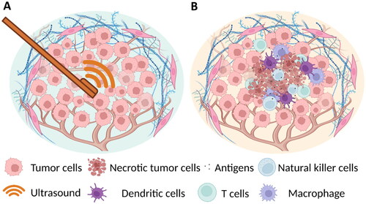
F
Histotripsy for Cancer Treatment
Non-invasive treatment
Used focused ultrasound
Based on the cavitation effect to destroy cancer tissue
No need needles, incisions, radiation or heat
Figure : Demonstration of how ultrasound work to remove cancer

Slide 3
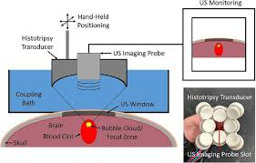
How does Histotripsy work
Ultrasound Focus : High-intensity focused ultrasound creates a cavitation cloud
Microbubble Formation : Bubbles expand and collapse, mechanically destroying targeted cancer cells.
Selective Destruction : Only tumor tissue is disputed, healthy tissue remains intact.
Figure : The use of HIFU to target the tumors

Slide 4
Key Advantages
01
No surgery or radiation
02
Precision: Highly targeted treatment that spares healthy tissues
01
Reduce risk of thermal damage compared to traditional methods like ablation.
02
Minimal Downtime and rapid recovery

Slide 5
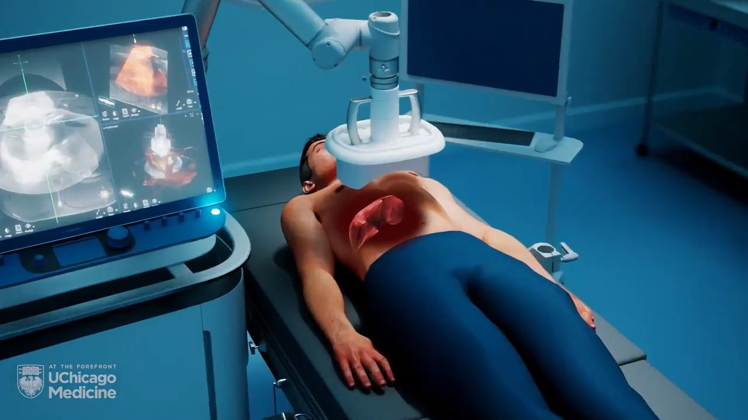
Clinical Success Rates
CT-based three-dimensional model generation
Successfully destroy 50-75% of tumor volume for liver cancer
Over 80% success rate in treated animals
FDA Approval (2023) in USA for treatment in Human.
Currently ongoing clinical trials for kidney cancer treatment and pancreas.
IN 2024
Figure : Demonstration of the Treatment Process

Slide 6
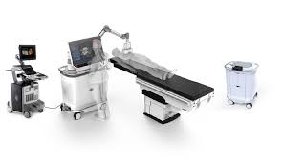
Current Research Institute
Figure : Edision platform by HistroSonics
University of Michigan (U-M) : HOPE4LIVER
UChicago Medicine (University of Chicago) : Conduct research on immunotherapy for liver
HistoSonics INC : Edison platform for liver cancer treatment
Virginia Tech : Research on cavitation and bubbles dynamics in histotripsy

Slide 7
Ultrasound Transducer Technology
High-intensity focused ultrasound (HIFU) transducers specifically designed for histotripsy. (High frequency operation typically 500 kHz to 1.5 MHz)
Waveform Generator / Pulse Generator (Microsecond precision in generating controlled bursts)
Cavitation Monitoring System (Ultrasound imaging or hydrophones to track cavitation events)
Ultrasound Imaging system (Real-time imaging to guide and monitor the histotripsy)
Robotic Positioning and Targeting System (High-precision movement system ensuring the transducer remain perfectly aligned with the tumor)
Power Amplifier (Capable of delivering the necessary high-power output).

